Slide 1
WMO & HMEI
OCP-HL-4
Public Private Engagement (PPE) for Early Warnings For All (EW4A)
Geneva, Switzerland, 26 May 2023
Joshua Campbell
Chair of HMEI

Slide 2
HMEI Exists Because
Why
We believe private companies play a critical role in the collaborative development of fit for purpose, sustainable solutions - equipment, services, and software - that empower public institutions to fulfill their role as the authoritative and protective voice for their citizens
We believe public institutions play a critical role in the protection and improvement of lives and livelihoods around the globe

Slide 3
HMEI Espouses
How
We build trust by aligning public, private, and academic intellect and capabilities on initiatives and resolutions that will empower WMO Members to carry out their duty to protect and enhance the lives and livelihoods of their citizens.
GBON
G3W
GCOS
OCP
WIS2.0
Resolution 1
ET/JET/RB/TT/WG
OSCAR
IOM-136
EW4ALL
SOFF
INFCOM
WIGOS
SCs
PPE
WMO Guide 8
SERCOM
TECO
GAW

Slide 4
HMEI Espouses
How
We build trust by aligning public, private, and academic intellect and capabilities on initiatives and resolutions that will empower WMO Members to carry out their duty to protect and enhance the lives and livelihoods of their citizens.
GBON
G3W
GCOS
OCP
WIS2.0
Resolution 1
ET/JET/RB/TT/WG
OSCAR
EW4ALL
IOM-136
SOFF
INFCOM
WIGOS
SCs
PPE
WMO Guide 8
SERCOM
TECO
GAW

Slide 5
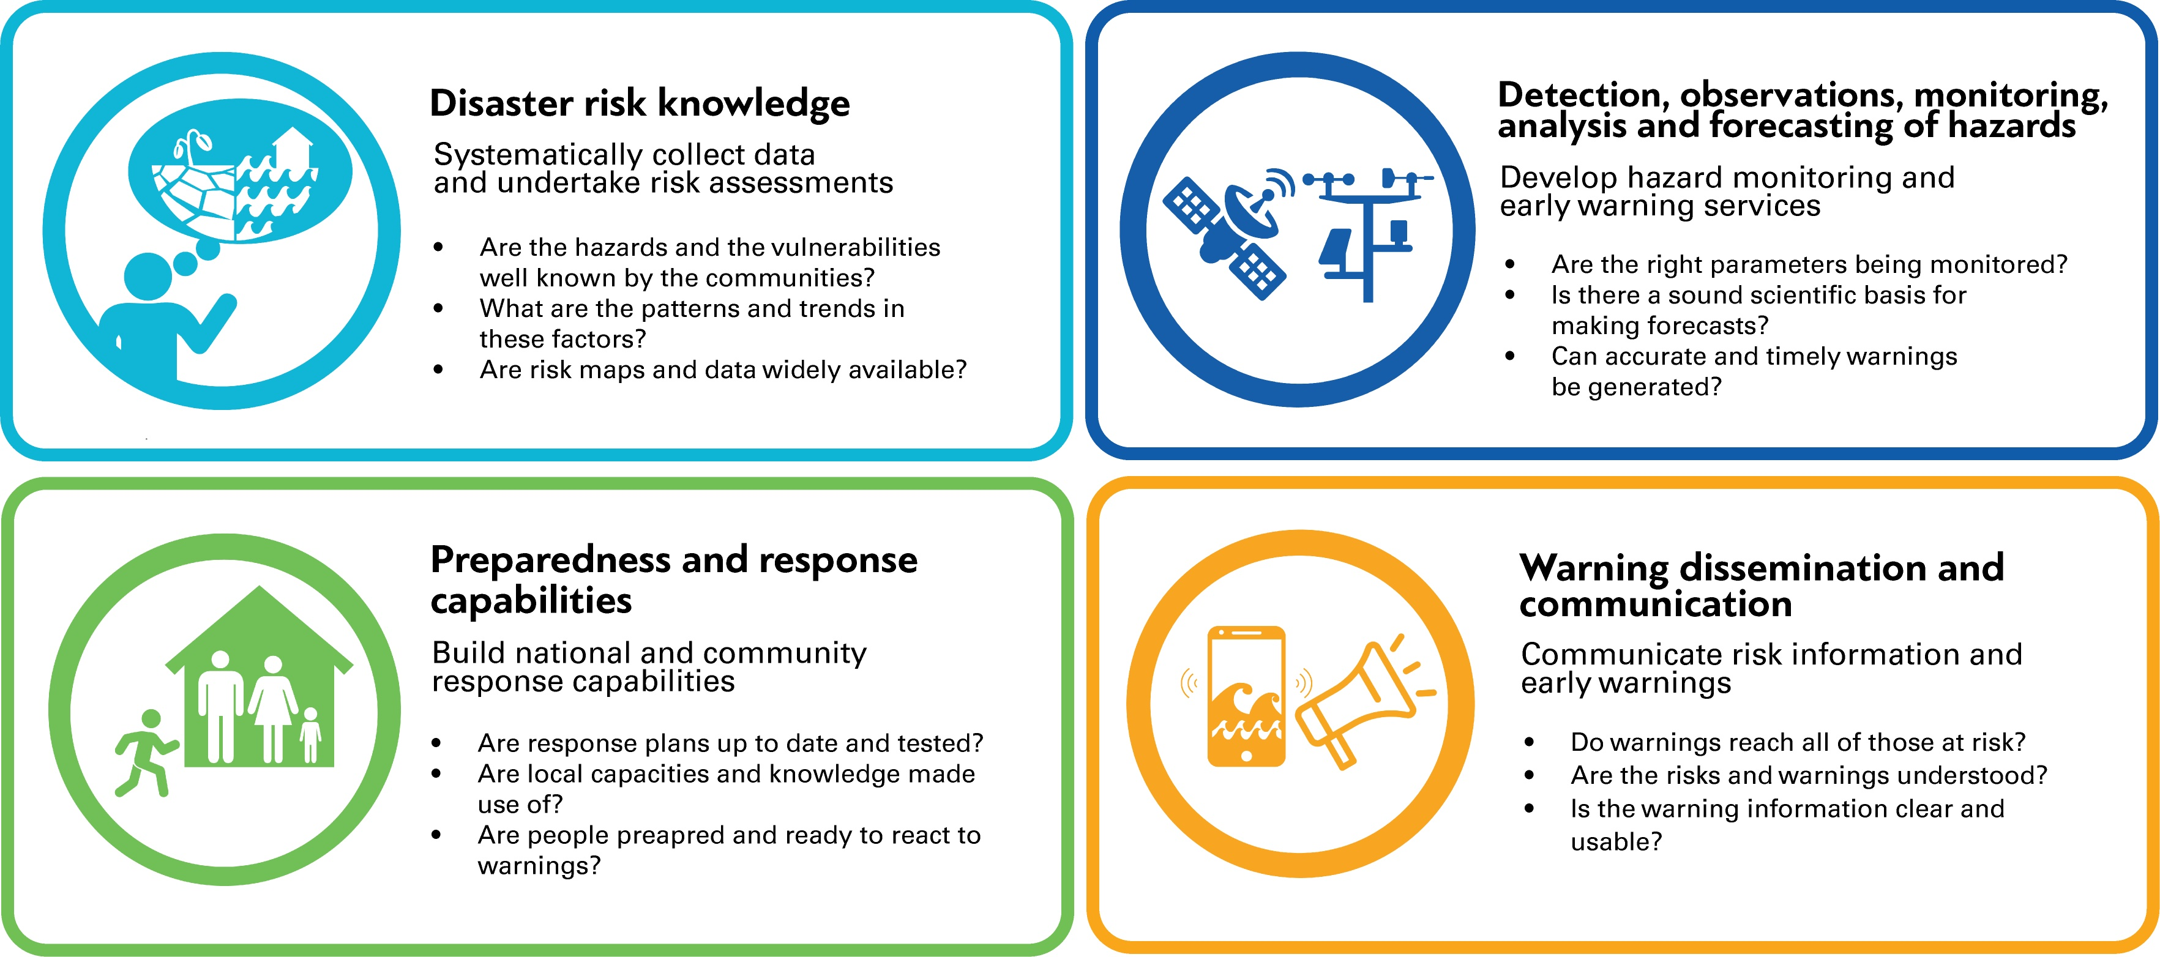
Early Warning Systems for All
Notes:
announcedix the United Nations would spearhead new action to ensure every person on Earth is protected by early warning systems within five years. He asked the World Meteorological Organization (WMO) to lead this effort and to present an action plan to achieve this goal at the next United Nations Climate Conference, later this year in Egypt. The developing plan is aligned with, and leverages, other mutually complementary COP27 priorities, such as the Action for Water Adaptation and Resilience (AWARE) initiative, particularly in the context of early warnings for floods and droughts – two of the most impactful climate hazards that societies face.
WMO has been working with Members and partner agencies to develop a global architecture for achieving the goal, to present as an action plan, connected relevant financial mechanisms at COP27. This will utilize advanced analysis to improve the understanding of the global status of early warnings, across the full early warning to early action value cycle and will include a mapping of international early warning development efforts already planned for the next 5 years. This work is designed to highlight where outstanding gaps remains, and where the international community should focus and invest additional efforts as a matter of urgency.

Slide 6
Early Warning Systems for All
EW4ALL
GBON
IOM-136
Resolution 1
SOFF
WIS2.0
Lessons from the past
Tender
Procure
Install
Commission
Done
ENTROPY
Notes:
announcedix the United Nations would spearhead new action to ensure every person on Earth is protected by early warning systems within five years. He asked the World Meteorological Organization (WMO) to lead this effort and to present an action plan to achieve this goal at the next United Nations Climate Conference, later this year in Egypt. The developing plan is aligned with, and leverages, other mutually complementary COP27 priorities, such as the Action for Water Adaptation and Resilience (AWARE) initiative, particularly in the context of early warnings for floods and droughts – two of the most impactful climate hazards that societies face.
WMO has been working with Members and partner agencies to develop a global architecture for achieving the goal, to present as an action plan, connected relevant financial mechanisms at COP27. This will utilize advanced analysis to improve the understanding of the global status of early warnings, across the full early warning to early action value cycle and will include a mapping of international early warning development efforts already planned for the next 5 years. This work is designed to highlight where outstanding gaps remains, and where the international community should focus and invest additional efforts as a matter of urgency.

Slide 7
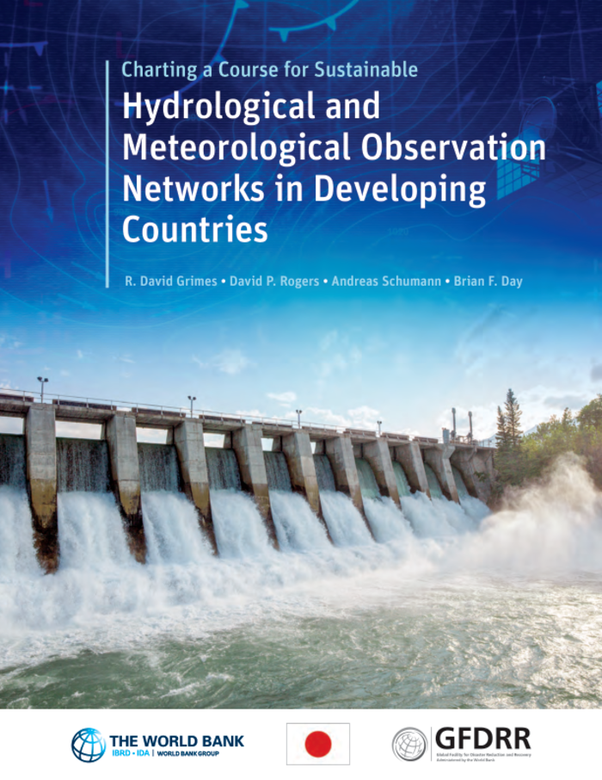
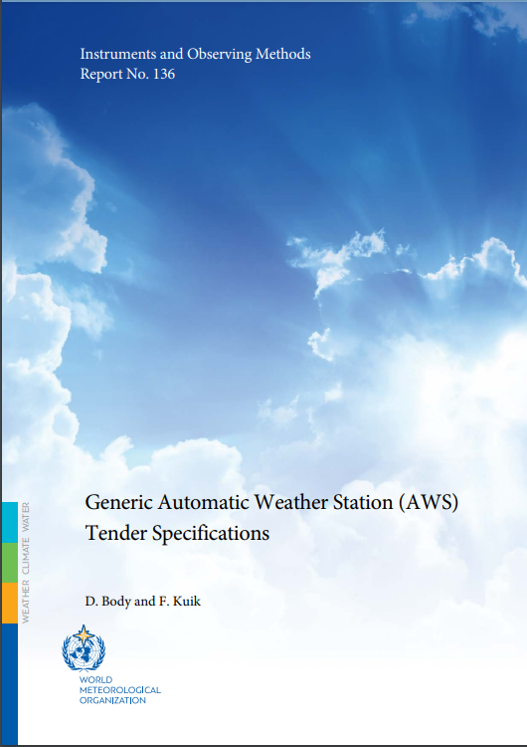
Early Warning Systems for All
EW4ALL
GBON
IOM-136
Resolution 1
SOFF
WIS2.0
Publications
Charting a Course for Sustainable Hydrological and Meteorological Observation Networks in Developing Countries
Link to doc
Generic Automatic Weather Station (AWS) Tender Specifications
IOM-136
Notes:
announcedix the United Nations would spearhead new action to ensure every person on Earth is protected by early warning systems within five years. He asked the World Meteorological Organization (WMO) to lead this effort and to present an action plan to achieve this goal at the next United Nations Climate Conference, later this year in Egypt. The developing plan is aligned with, and leverages, other mutually complementary COP27 priorities, such as the Action for Water Adaptation and Resilience (AWARE) initiative, particularly in the context of early warnings for floods and droughts – two of the most impactful climate hazards that societies face.
WMO has been working with Members and partner agencies to develop a global architecture for achieving the goal, to present as an action plan, connected relevant financial mechanisms at COP27. This will utilize advanced analysis to improve the understanding of the global status of early warnings, across the full early warning to early action value cycle and will include a mapping of international early warning development efforts already planned for the next 5 years. This work is designed to highlight where outstanding gaps remains, and where the international community should focus and invest additional efforts as a matter of urgency.

Slide 8

HMEI – Commitment
affirm and support the central role of NMHSs as the authoritative voice – public health and safety
share our technical expertise¹ with, and learn from, WMO, WMO Members, and other international organizations to ensure policies are informed and implemented with the best science, innovation, and practices
engage with WMO to align public, private, and academic initiatives that will empower WMO Members to achieve their objectives
¹ Engage with Publications, Expert Teams, Joint Expert Teams, Working Groups, Commissions, Workshops, Webinars, Innovation Demos, and Collaborative Pilot Projects
Notes:
HMEI members affirm and support the central role of met services as the single authoritative voice for weather alerts, especially when it pertains to public health and safety

Slide 9
HMEI – Commitment (more specifically)
complete and present a code of ethics to better enhance public private engagement with WMO
consider the phase II of IOM-136 to add upper air
continued engagement and enhanced reporting with WMO working bodies, particularly expert teams, developing a robust reporting mechanism to inform industry of WMO initiatives
Notes:
HMEI members affirm and support the central role of met services as the single authoritative voice for weather alerts, especially when it pertains to public health and safety

Slide 10

Thank You!

