Slide 1
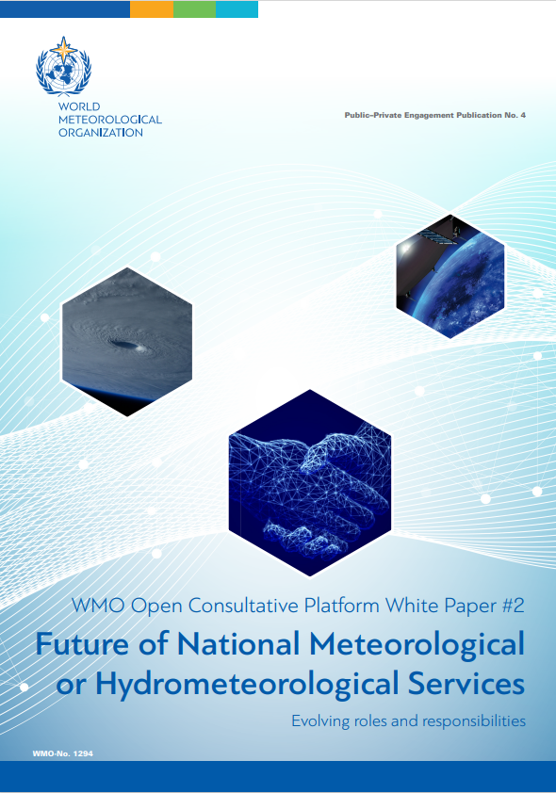
Third High-Level Session of
the Open Consultative Platform (OCP-HL-3)
20 June 2022
WMO Open Consultative Platform White Paper #2
Future of National Meteorological or Hydrometeorological Services:
Evolving Roles and Responsibilities
Gerhard Adrian
President of WMO

Slide 2
WMO OCP White Paper #2
WP#2 addresses identified issues and challenges under the overarching question “How do you see the NMSs in 2030?” and is a collective endeavor of more than 30 lead experts.
The objectives of WP#2: to inform key decisions on the future development of NMSs, consider risks, opportunities and scenarios, and enable better governance choices,
The conclusions will present key messages and recommendations derived from the comprehensive analysis of the evolving societal needs and observed trends in the technological and operational ecosystems in which NMSs operate.
Notes:
As the Lead Author, I am delighted to launch WMO OCP White Paper #2 on the Future of National Meteorological or Hydrometeorological Services (NMSs): Evolving Roles and Responsibilities.
This White Paper is a collective endeavor of more than 30 lead experts of the world.
It will provide comprehensive analysis of the evolving societal needs and observed trends in the technological and operational ecosystems in which NMSs operate. It will present key messages and recommendations derived from such analysis.
The primary objective of this White Paper is to inform key decisions on the future development of NMSs, considering risks, opportunities and scenarios for the foreseen institutional, technological and operational changes, and enabling better governance choices.
[Next slide please]

Slide 3
WP #2 Contributors
Lead Author: Gerhard Adrian
Contributing Authors: Ishaam Abader, Klemen Bergant, Fabio Bernal, Jan Bester, Tom Copping, Penny Endersby, Phil Evans, Naoyuki Hasegawa, Stephen Hunt, Arlene Laing, Albert A.E. Martis, Elena Mateescu, Florence Rabier, Yuri Simonov, Roar Skålin, A.R. Subbiah, Ken Takahashi Guevara, Tran Hong Thai, Vladimir Tsirkunov, Louis W. Uccellini and Guotai Zhuang
Reviewers: Gilbert Brunet, Yolanda González Hernández, Michel Jean, Agnes Lawrence Kijazi, Daouda Konate, Ian Lisk, Kornélia Radics, Andrea Celeste Saulo, Albert Klein Tank, Jay Wilson and John W. Zillman
Notes:
This is the list of contributing authors and reviewers, who dedicated their time and efforts for White Paper #2.
A drafting group of leading experts from all regions and stakeholders was set up, and eventually 21 leading experts provided fruitful written contribution and more than 10 independent experts also devoted their time to review this White Paper.
I therefore believe that this White Paper represents a wide spectrum of views and opinions based on different national and professional experiences and interests.
I would like to take this opportunity to express my sincere appreciation for the efforts of these people.
[Next slide please]

Slide 4
WHAT? (2/2) – WMO OCP White Paper #2
Structure and Corresponding Questions
Executive Summary
Introduction
Historical Perspective
Current landscape and baseline
Evolving role and operation of National Meteorological or Hydrometeorological Services
Cooperation and engagement with stakeholders
Evolving development of human resources
Vision of the future
Conclusions
Notes:
This is the structure of the white paper.
It is a fairly-long white paper, so you can first capture the essence by reading the Executive Summary, Introduction, and Conclusions.
It is also compiled in such a way that it does not necessarily need to be read in order from the beginning.
[Next slide please]

Slide 5
Conclusions
(1/6) with key messages and recommendations
Rapidly changing environment
NMSs must continually evolve to fulfil their public safety mandate.
NMSs should focus on increasing the benefits of partnerships and collaborate widely.
Notes:
[Explanatory notes: This part comes from first four paragraphs of Chapter 8]
Now I will share with you the essence of the conclusions, which are comprised of key messages and recommendations.
A major consideration by the drafting team and reviewers was the rapidly changing environment, influenced by many external and internal factors.
The ability of NMSs to adapt to such changing conditions and to benefit from new technologies will require agility, foresight and change management.
NMSs therefore must continually evolve to become more efficient, more effective and higher performing, to remain relevant and competitive, and to fulfil their public safety mandate.
In doing so, NMSs should focus on increasing the benefits of partnerships and collaborate widely across the public and private sectors, as well as with central and regional governments.
I now will show excerpted key messages and recommendations.
[Next slide please]

Slide 6
Conclusions (2/6) Institutional strengthening
There is no one-size-fits-all model, however, all NMSs have a common need to enhance the benefits they provide.
National legal frameworks under which NMSs operate should focus on defining better the mandate & functions of NMSs.
NMSs are regarded as vital components of the national resilience, as authoritative sources of data, advice and modelling capability.
Strong efforts should be made to ensure better recognition by the govts of the socioeconomic benefits of free and unrestricted access to NMS data.
Notes:
[Explanatory notes: This part comes from 8.1 Institutional strengthening of Chapter 8]
First one is Institutional strengthening,
There is no one-size-fits-all model, since NMSs vary significantly, however, all NMSs have a common need to enhance the benefits they provide.
For example, in the afore-mentioned changing environment, effort towards improving national legal frameworks should focus on defining better the mandate & functions of NMSs, along with possible stakeholders’ roles.
This is to ensure that NMSs are regarded as vital components of the national resilience.
Another example is about data, which is a fuel for all stakeholders. Strong efforts should be made to ensure better recognition by the governments of the benefits of free and unrestricted access to NMS data, which should result in allocation of more resources to allow NMSs to provide data for socioeconomic needs.
[Next slide please]

Slide 7
Conclusions
(3/6)
Changing operational environment
The global digital drive is calling for an accelerated digital transformation of all parts of the value chain.
The public cloud & pervasive Internet, offer a new route to enable NMSs to access improved forecasting skill.
Development of appropriate digital strategies and research avenues is desirable.
Utilizing the WMO Unified Data Policy will benefit the performance of every NMS.
Notes:
[Explanatory notes: This part comes from 8.2 Changing operational environment of Chapter 8]
The next one is on Changing operational environment,
The global digital drive is calling for an accelerated digital transformation. The automation will lead to organizational changes & reorientation of their service delivery.
Also, the public cloud & pervasive Internet offer a new route to access improved forecasting skill for smaller NMSs.
Therefore, development of appropriate digital strategies and research avenues is desirable.
In relevant strategies and actions, realizing the opportunities for utilizing the WMO Unified Data Policy will benefit the performance of NMSs and should be prioritized.
[Next slide please]

Slide 8
Conclusions
(4/6)
Partnerships
Progress will require inclusive multisectoral partnerships.
Partnerships and collaboration accelerate improvements in every step of the value chain.
Stronger partnerships are beneficial for the sustainability of basic infrastructure.
The concept of co-design and co-development allow a flow of innovations, resulting in better services for societies.
Notes:
[Explanatory notes: This part comes from 8.3 Partnerships of Chapter 8]
With regard to the Partnerships, which is everyone’s concern,
Our progress will require inclusive multisectoral partnerships.
Partnerships and collaboration with the private sector and academia have the potential to accelerate improvements. The sustainability of basic infrastructure is an area where opportunities arising.
Therefore, leadership in interdisciplinary partnerships is needed.
NMSs also need to embrace the concept of co-design and co-development, which will result in better services for societies.
[Next slide please]

Slide 9
Conclusions
(5/6)
International cooperation
International cooperation through WMO ensures free and unrestricted international data exchange.
Regional collaborations are an extremely effective way of raising the collective performance.
Bridging the capacity gap between NMSs of developing and developed countries will require innovative international cooperation.
Notes:
[Explanatory notes: This part comes from 8.4 International cooperation of Chapter 8]
Then, about International cooperation,
Cooperation through WMO must continue and expand, in particular, ensuring free and unrestricted international data exchange and capacity development.
Regional collaborations are an extremely effective way of raising the collective performance, which has been pushed forward by WMO.
Bridging the capacity gap will require innovative international cooperation with a focus on delivering core information and services, in particular, warning services and long-term sustainability.
[Next slide please]

Slide 10
Conclusions
(6/6)
Human resources and leadership
Leadership, talent management, skills development, equality and diversity are essential aspects in human resources strategies.
Investment in the skills required to effectively leverage partnerships is becoming increasingly important.
NMS Director career development planning should account for the challenging role of coordinating with all national stakeholders.
Notes:
[Explanatory notes: This part comes from 8.5 Human resources and leadership of Chapter 8]
Last messages are on Human resources and leadership,
Particularly essential aspects are leadership, talent management and skills development.
As skills to leverage partnerships is becoming increasingly important, NMS Director career development planning should account for coordinating with all national stakeholders.
Director of NMSs should endeavour to be leaders of national weather, climate and water enterprises.
[Next slide please]

Slide 11
WHERE is it available?
WP#2 is available at WMO Library online as WMO-No. 1294.
Original written contributions are also published as Annex/Part II – Original inputs to White Paper #2 just as in the case of White Paper #1 (WMO-Pub No. 1263).
Notes:
[Explanatory notes: Since WP#2 is being finalized and not uploaded yet, this slide needs modification.]
These are the major key messages and recommendations excerpted from White Paper.
For more details, please go to the WMO library online and find WMO Pub No. 1294.
Original contributions from authors are also available.
Hope this White Paper and my presentation will be useful for the future of NMSs and all stakeholders as well as for the panel discussion.
[Next slide please]

Slide 12
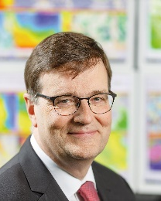
















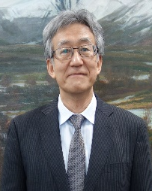




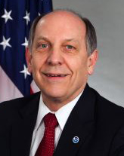

THANK YOU
https://public.wmo.int/ppe and https://ppe-openplatform.wmo.int/
Notes:
Finally, I would like to add something important: these are the photos of contributing authors (and some assistants).
Thank you.

